Slide 1




PROBLEM SOLVING PROCESS
Class VIII
lab 9

Slide 2
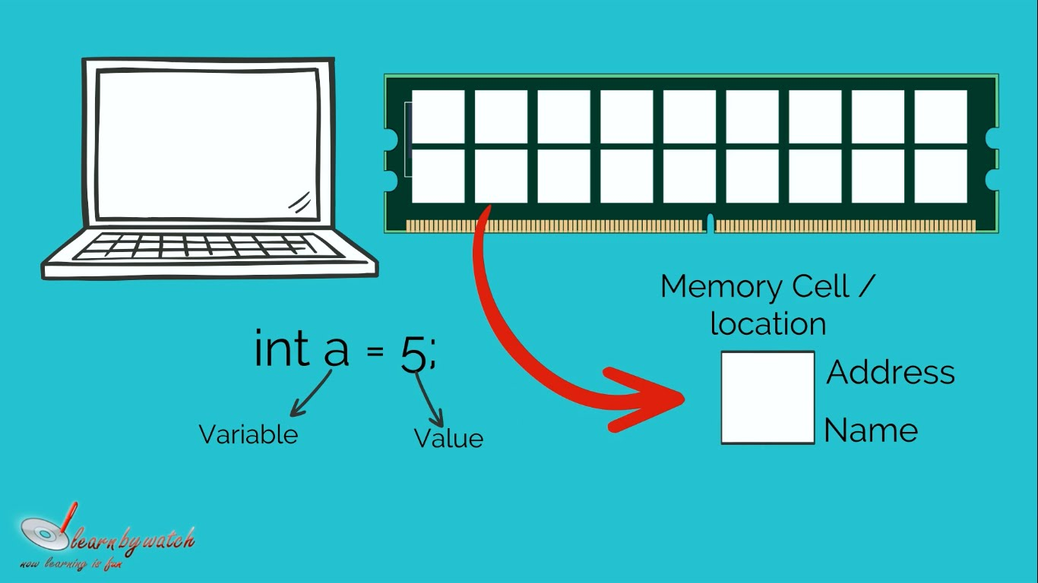

Variable

Slide 3
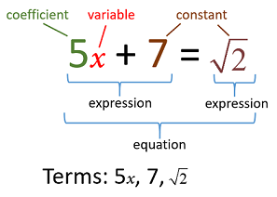
Constant
a specific
number or
a symbol

Slide 4
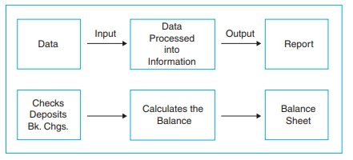
Data Types
a classification of data

Slide 5
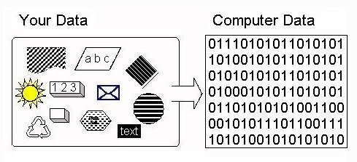
How the Computer Stores Data

Slide 6
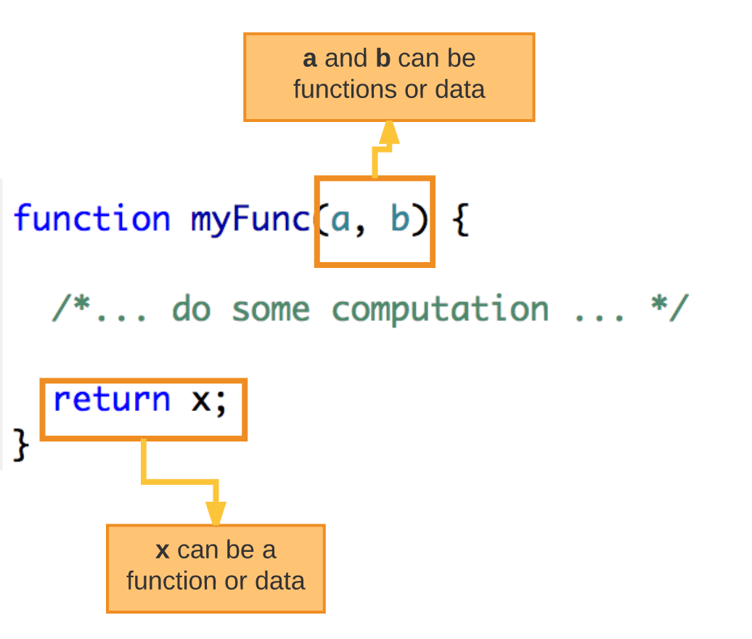
Function
small sets of instructions that perform specific tasks and return values

Slide 7
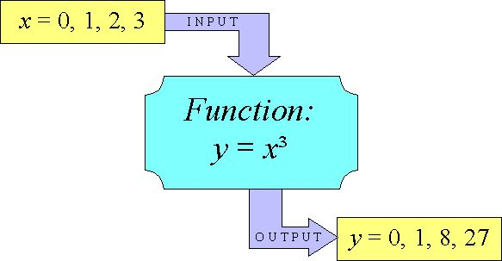
How Function Works?

Slide 8
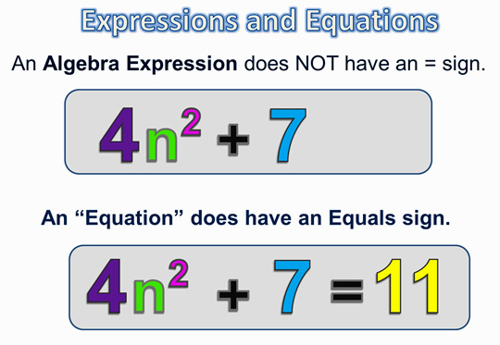

Slide 9



